Slide 1
Memory Profiling and Optimized Distributed Training for Billion Parameter LLMs
Presented by-
Megha Agrawal, MS in Machine Learning
Team name: Goodenough, 1 Member
Course: Deep Dsitributed Learning (16:332:534:01), Fall 2025
Instructer: Dr. Zhao Zhang

Slide 2
Outline
Problem Statement (What your project is about ? )
Tech stack
Approach
Experiments
Result Analysis
GPU hour usages and GPU Utilization
Challenges & Future scope
Conclusion (Progess, Discussions)

Slide 3
Problem Statement (What my project is about ? )
Problem Statement:
Difficult to train billion parameter LLMs on single GPU because of memory constraints
Loading the model including model states and residual parameters
Training the model with effective batch size, adequate sequence lengths, Activations
Objective:
Memory profiling of large models during training to gain insights about:
GPU memory consumption (Maximum reserved, allocated memory )
How optimizer/parameter/gradient sharding using ZeRO1/2/3 affects GPU memory
How Activations, temporary buffers related memory requirement causes OOM errors
How long-sequence datasets stress the memory uses
Memory Optimized fine-tuning of LLMs:
Minimum number of GPUs needed with maximum GPU utilization (~90% )
Optimized selection of hyperparameters to have stable training without compromising model output performance.
Notes:
Total memory consumption of a model depends on 1) model states 2) residual parameters; Training the model with suitable batch size, adequate sequence length to keep the activation memory that can fit the GPU memory.

Slide 4
Tech Stack and System Requirements
Datasets:
CNN/Dailymail
~287k Articles-Summary text pairs
Mean input/ output tokens: 781/56
CCDV/govreport-summarization
~17,517 report-summary text pairs
Mean input/ output tokens: 6400/240
ML Models:
Google/Flant5-xl LLM
3B parameters
Encoder-decoder style LLM
Google/ul2
20 B parameters
Encoder-decoder style LLM
ML task:
Text Summarization
Frameworks:
Pytorch
Transformers
DeepSpeed AI
Memory Profiling Tool
Torch cuda memory API
Pytorch Profiler
Visualization Tools
Tensorboard
Perfetto UI
Graphs, JSONs, Logs
System Hardware:
Perlmutter HPC
40 GB, A100 GPUs
HPE slingshot NICs

Slide 5
Approach – Theoretical Analysis
Memory needed for a P parameter Model |  |  |  | Total
Model states: | Model parameters | Gradients | Adam Optimizer | Total
 | FP16 : 2 bytes | FP16: 2 bytes | FP32: 12 bytes | 16* P
Residual Parameters: | Activations | Temporary Buffers | Memory Fragmentation
 | batch_size* (in+out token len) *dmodel*layers | ~ | Dynamic (depends on hardware)
Optimal Calculated Memory:
Model | Model States (MS) | Activation, attention/MLP/overheads (per gpu) | DeepSpeed zero-1 (per gpu) ,only MS | DeepSpeed zero-2 (per gpu), only MS | DeepSpeed zero-3 (per gpu), only MS | Num_GPU A100 (per gpu)
Flant5-XL-3B | 48 GB | 1 Gb, ~3 GB, | 21 GB | 16.5 GB | 12 GB | 4
Ul2-20B | 320 GB | 4.8 GB , ~10+ | 95 GB | 57.5 GB | 20 GB | 16

Slide 6
Approach- Workflow
[📥 ] Load Dataset: HuggingFace Datasets
[🧹 ] Preprocessing: Tokenization, Padding, Filtering
[⚙️ ] Training / Fine-Tuning: Huggingface Pretrained model DeepSpeed ZeRO-1/2/3/++, PyTorch Profiler, Memory Tracking
[📊 ] Validation: Eval Loss curves
[💾 ] Save Checkpoints: Sharded DeepSpeed Checkpoint, zero_to_fp32, Save Trace
[🧪 ] Test Evaluation: Generate Rouge Score on Test Set
[📈 ] Visualization: Memory Timeline, Throughput Charts]

Slide 7
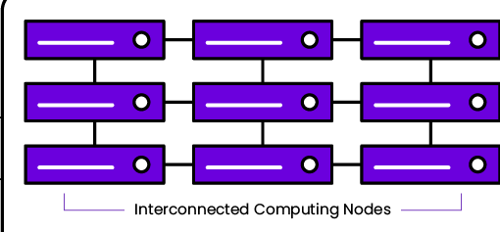
profiling-centric LLM fine-tuning pipeline
Training Pipeline
Evaluation/Test Pipeline
Dataset (CNN/dailymail, ccdv/govreport)
FlanT5-Xl
Or
UL2
Memory profiling APIs
Pytorch Profiler
DeepSpeed Zero stage config
valid dataset
Trained Model
Training on multimode, multi-GPU HPC cluster
Performance Scores

Slide 8
Experiments
Experiment1
Memory profiling and Fine-Tuning with DeepSpeed zero1
Dataset: CNN/Dailymail
Model: Flant5-XL
Batch Size: 32
Samples: ~10k
Input seq len: 512
Output seq len: 128
Num of GPUs: 4
Memory Optimization techniques:
Mixed precision
Pin memory
Gradient accumulation
Experiment2
Memory profiling and Fine-Tuning with DeepSpeed zero2
Dataset: CNN/Dailymail
Model: Flant5-XL
Batch Size: 32
Samples: ~5k
Input seq len: 512
Output seq len: 128
Num of GPUs: 4
Memory Optimization techniques:
Mixed precision
Pin memory
Gradient accumulation
Experiment3:
Memory profiling and Fine-Tuning with DeepSpeed zero3/zero++
Dataset: ccdv/govreport-summarization
Model: UL2
Batch Size: 64
Samples: ~10k
Input seq len: 2048
Output seq len: 256
Num of GPUs: 16
Memory Optimization techniques:
Mixed precision
Pin memory
Gradient accumulation
Gradient Checkpoints
DeepSpeedMemoryFlush
Zero3 ++

Slide 9
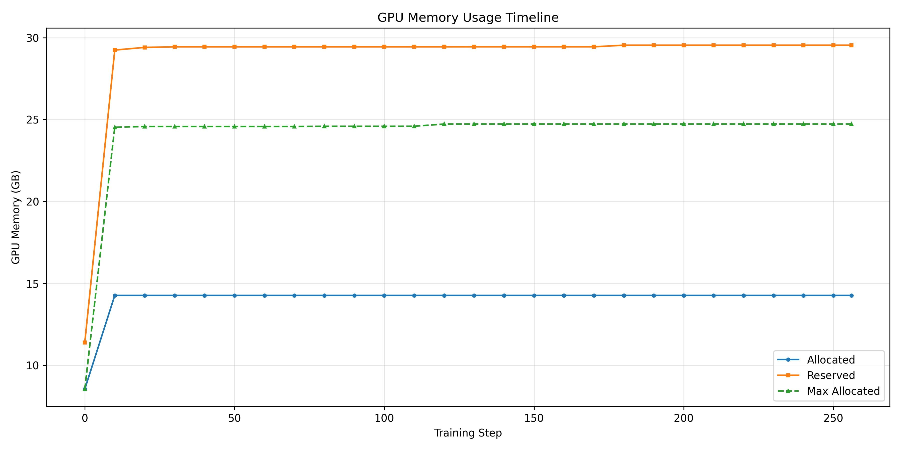
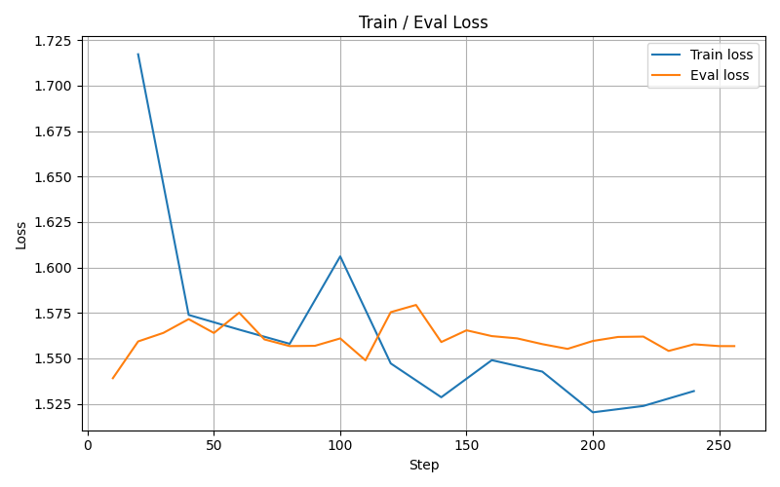
Result Analysis- Experiment 1
Output Metric:
rouge1: 34.5828
rouge2: 14.4021
rougeL: 25.6833
rougeLsum: 25.6634

Slide 10
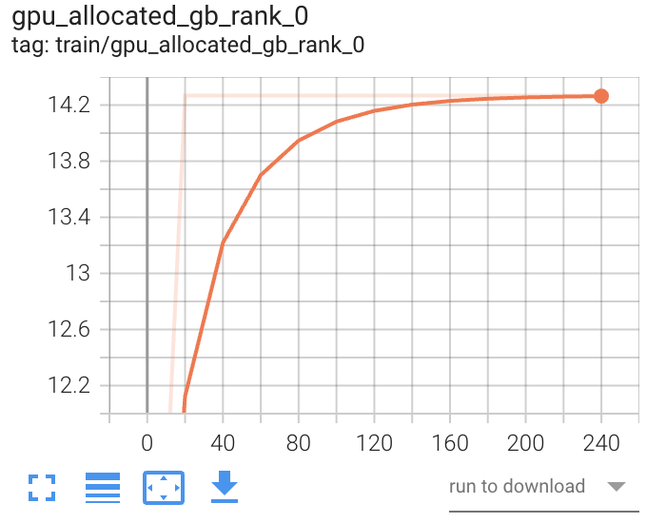
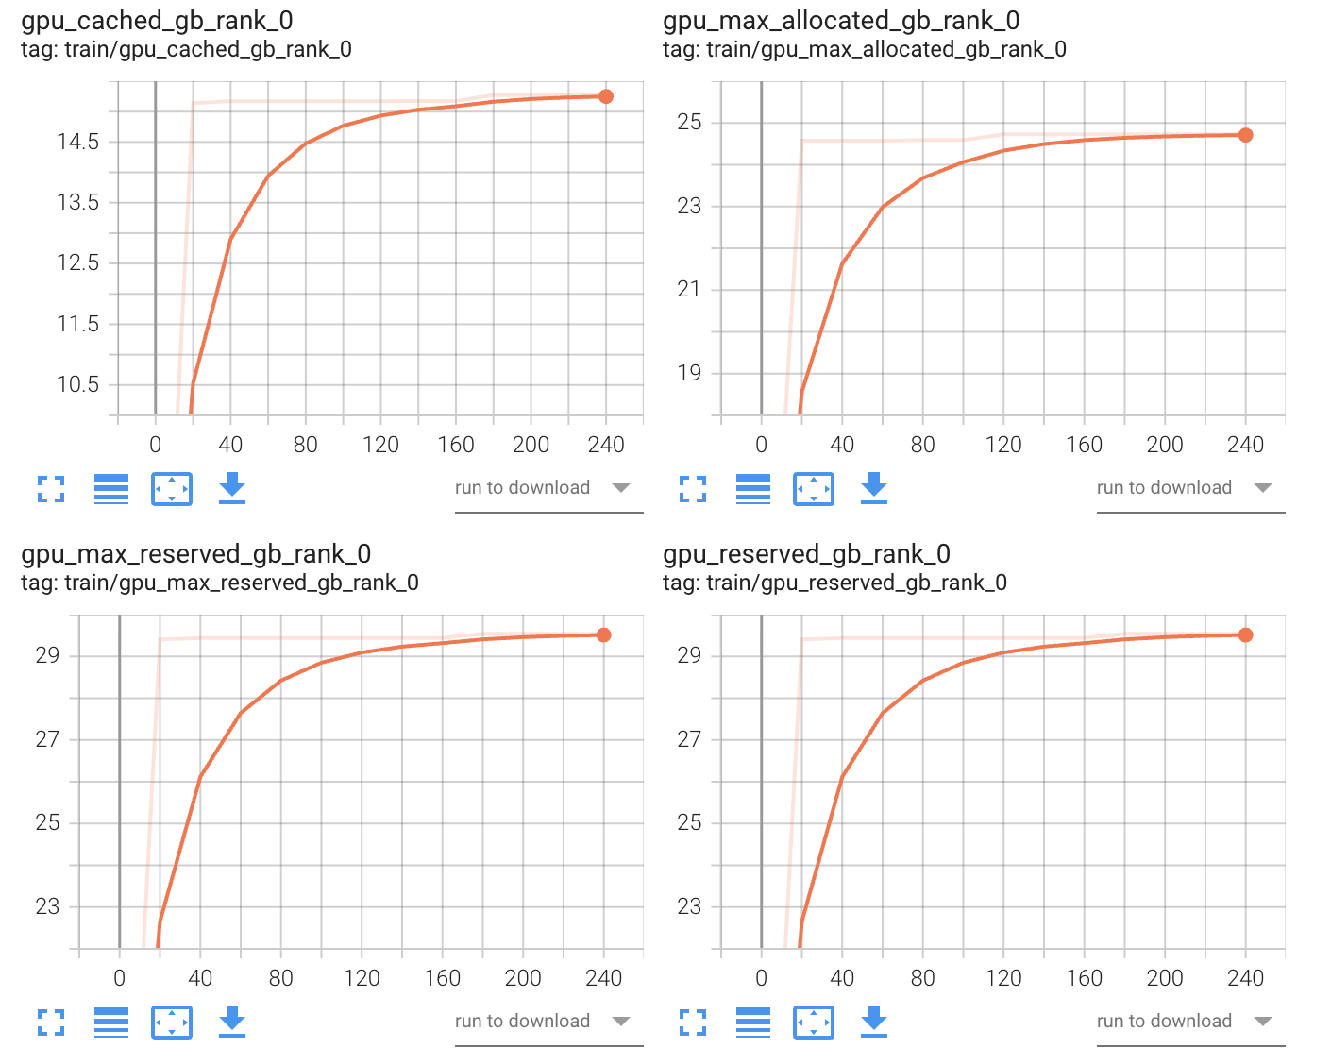
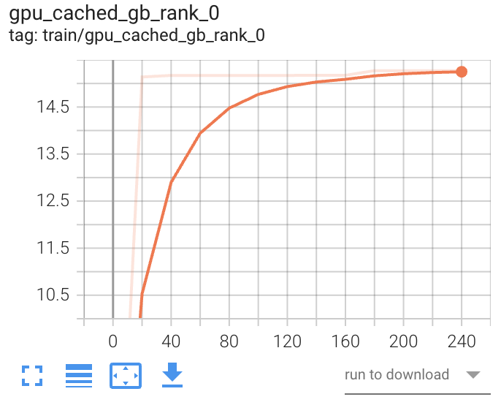
Result Analysis- Experiment 1
TensorBoard result:
Cached memory result can be considered to be useful for activations, other overhead

Slide 11
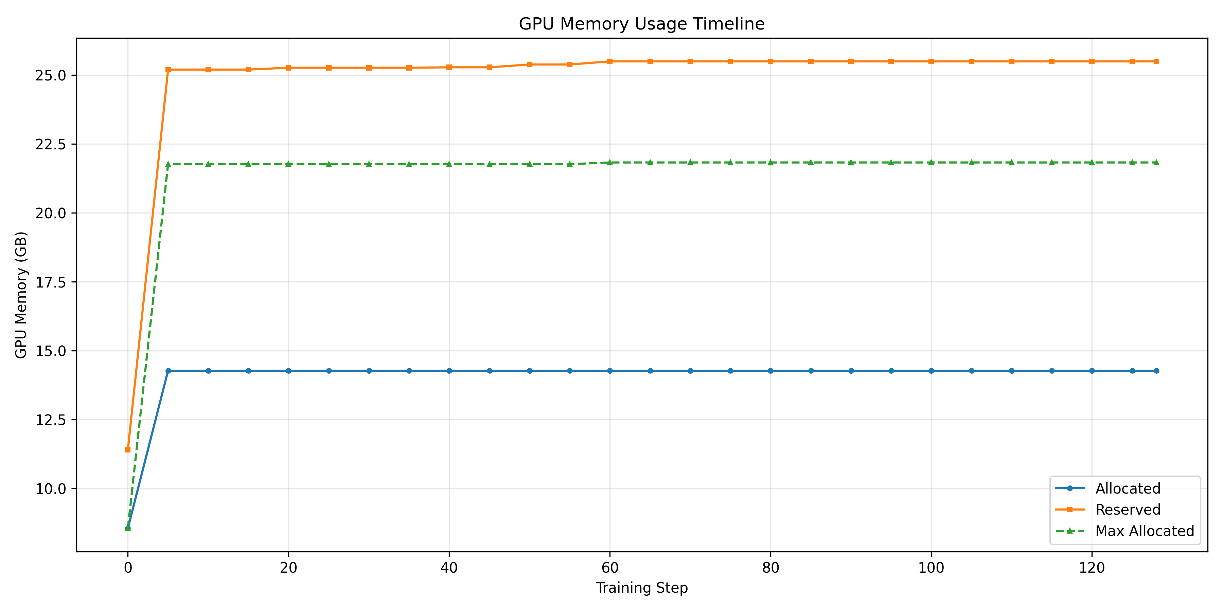
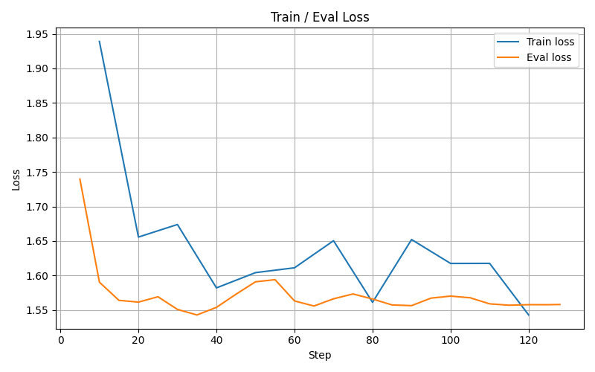
Result Analysis- Experiment 2
Output Metric:
rouge1: 34.3781
rouge2: 14.7272
rougeL: 25.9640
rougeLsum: 25.9448

Slide 12
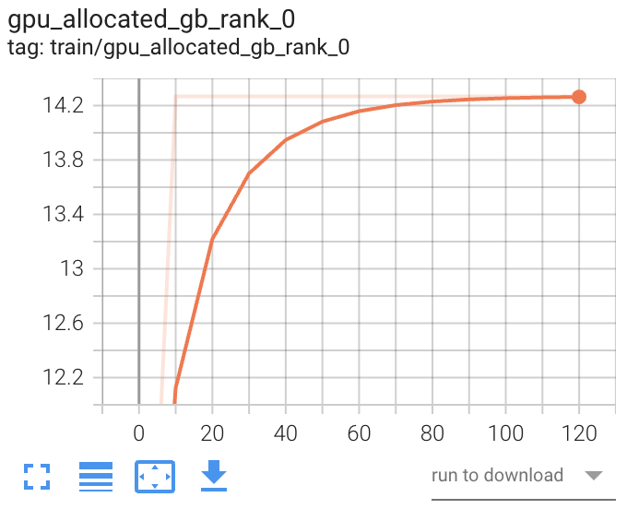
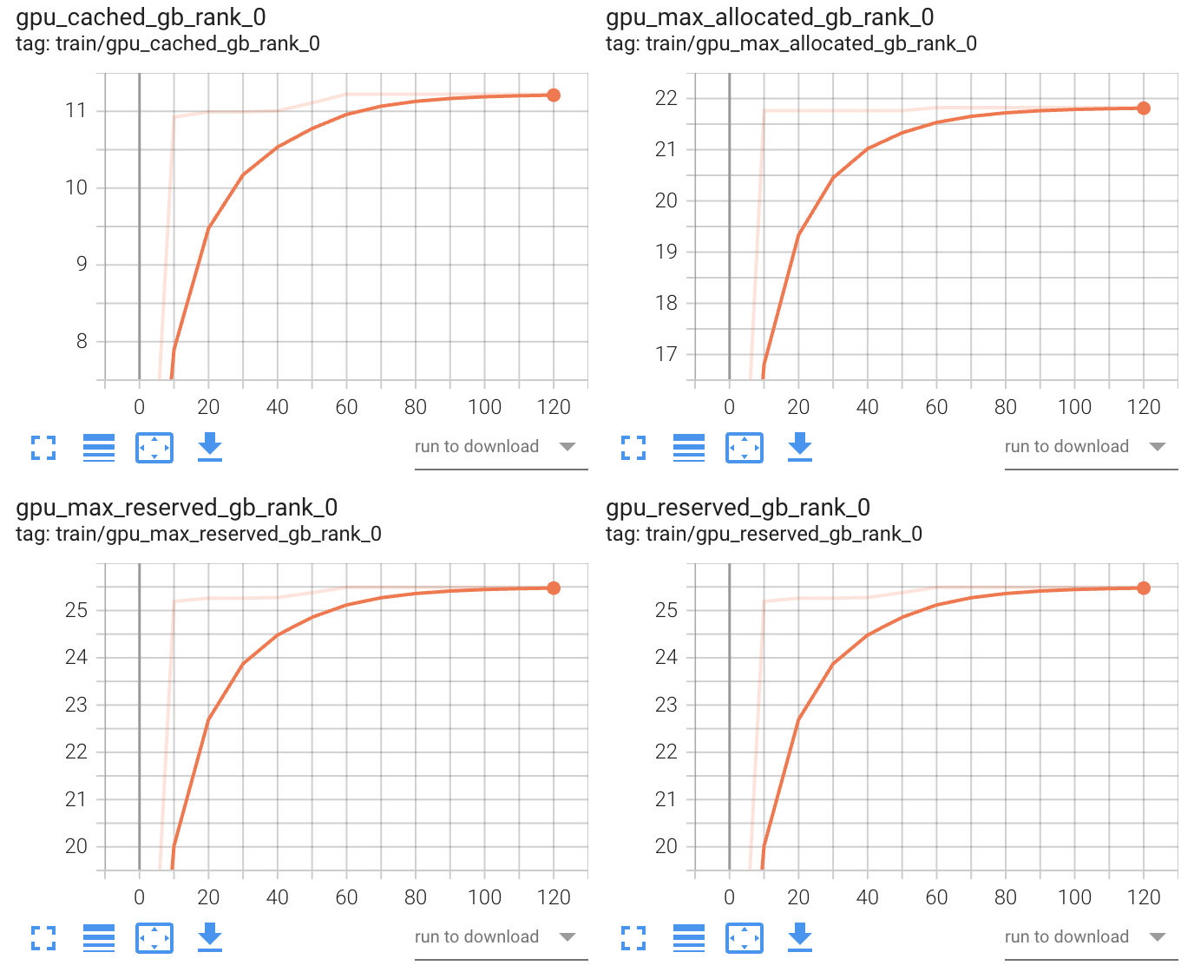
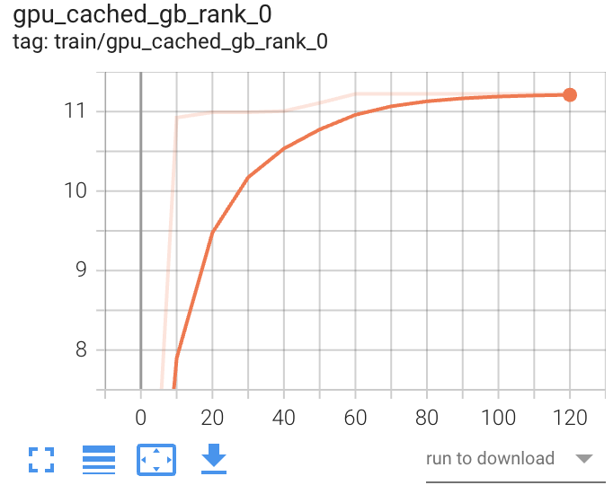
Result Analysis- Experiment 2
TensorBoard result:
Cached memory result can be considered to be useful for activations, other overhead

Slide 13
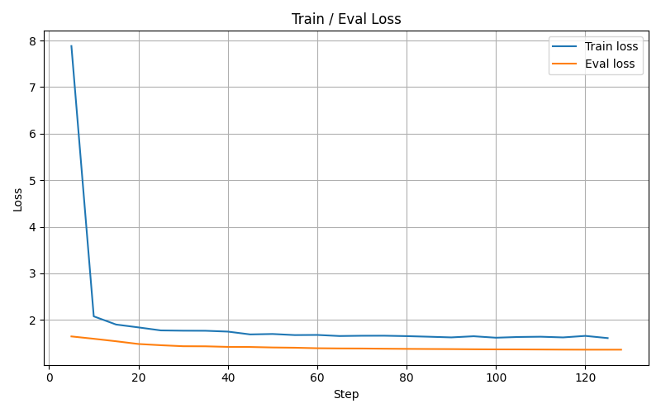
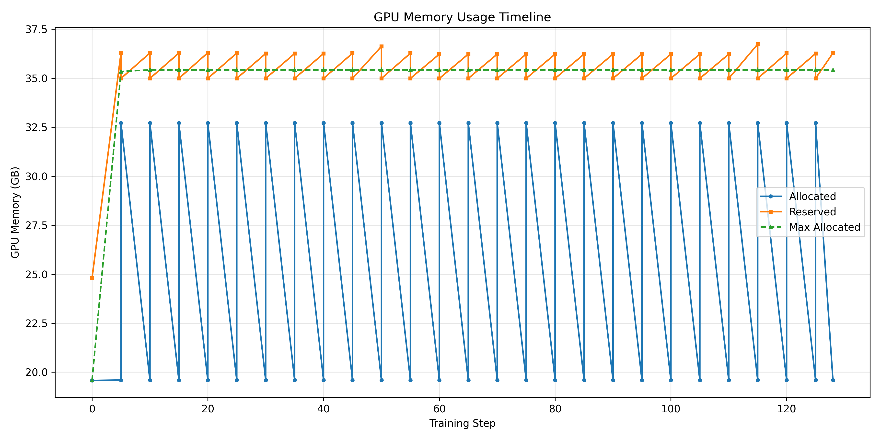
Result Analysis- Experiment 3

Slide 14
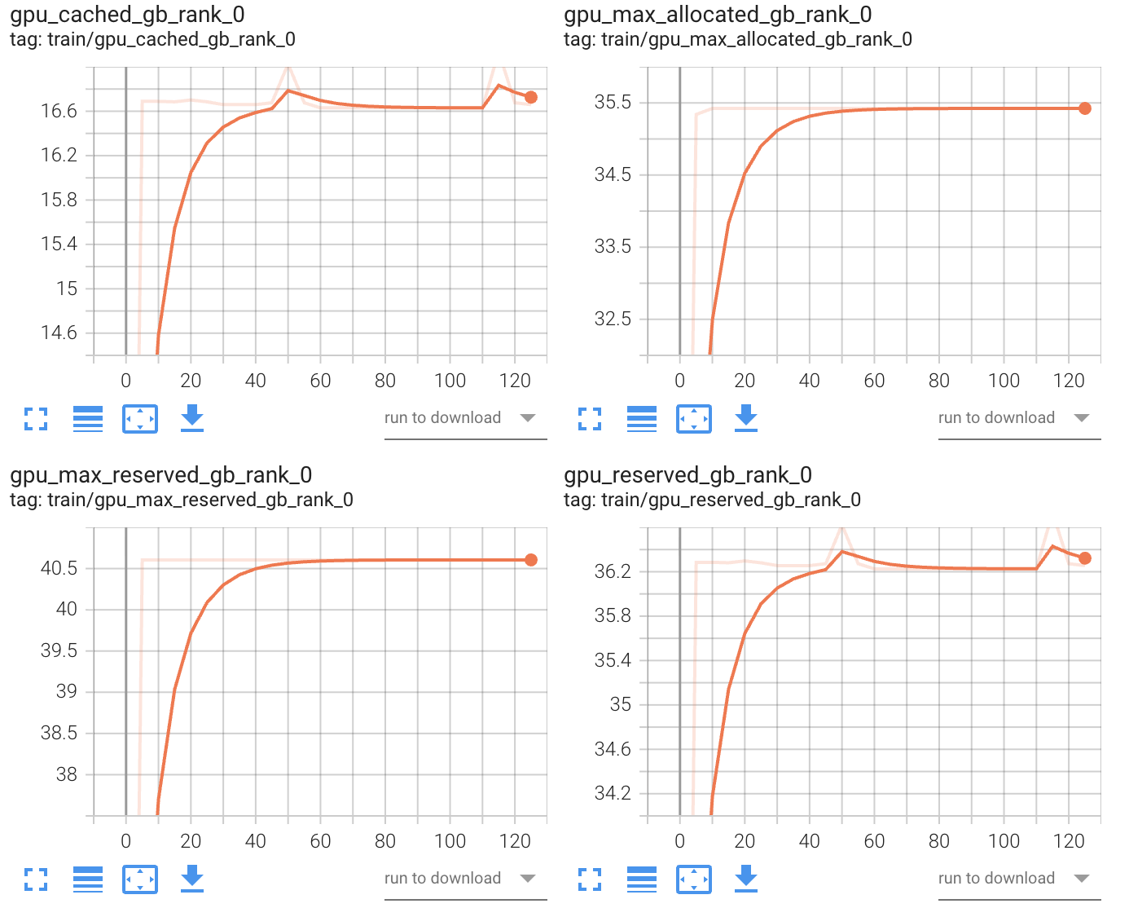
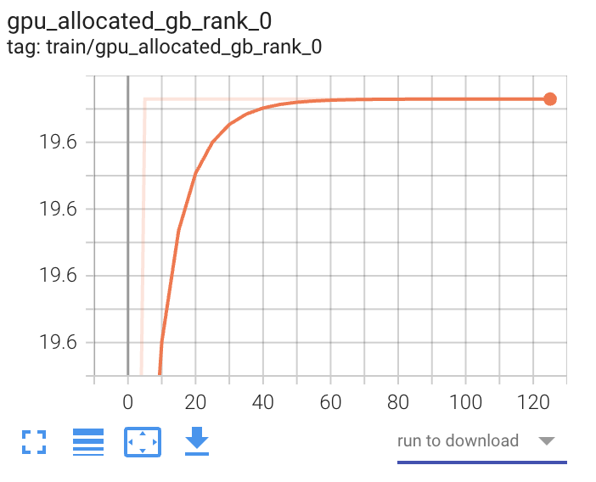
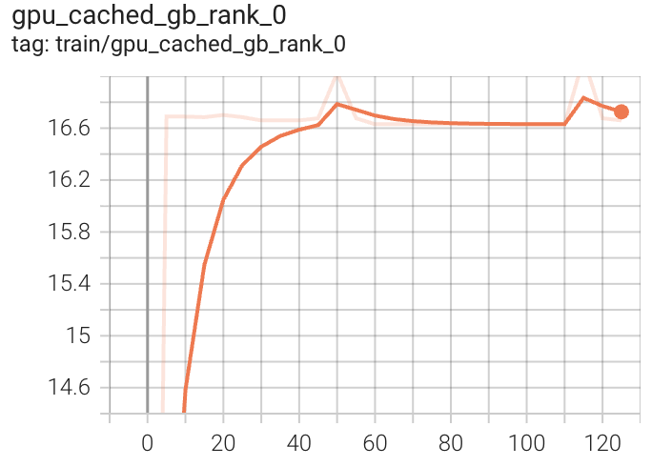
Result Analysis- Experiment 3
TensorBoard result:
Rank 0 GPU memory profiling
Cached memory result can be considered to be useful for activations, other overhead

Slide 15
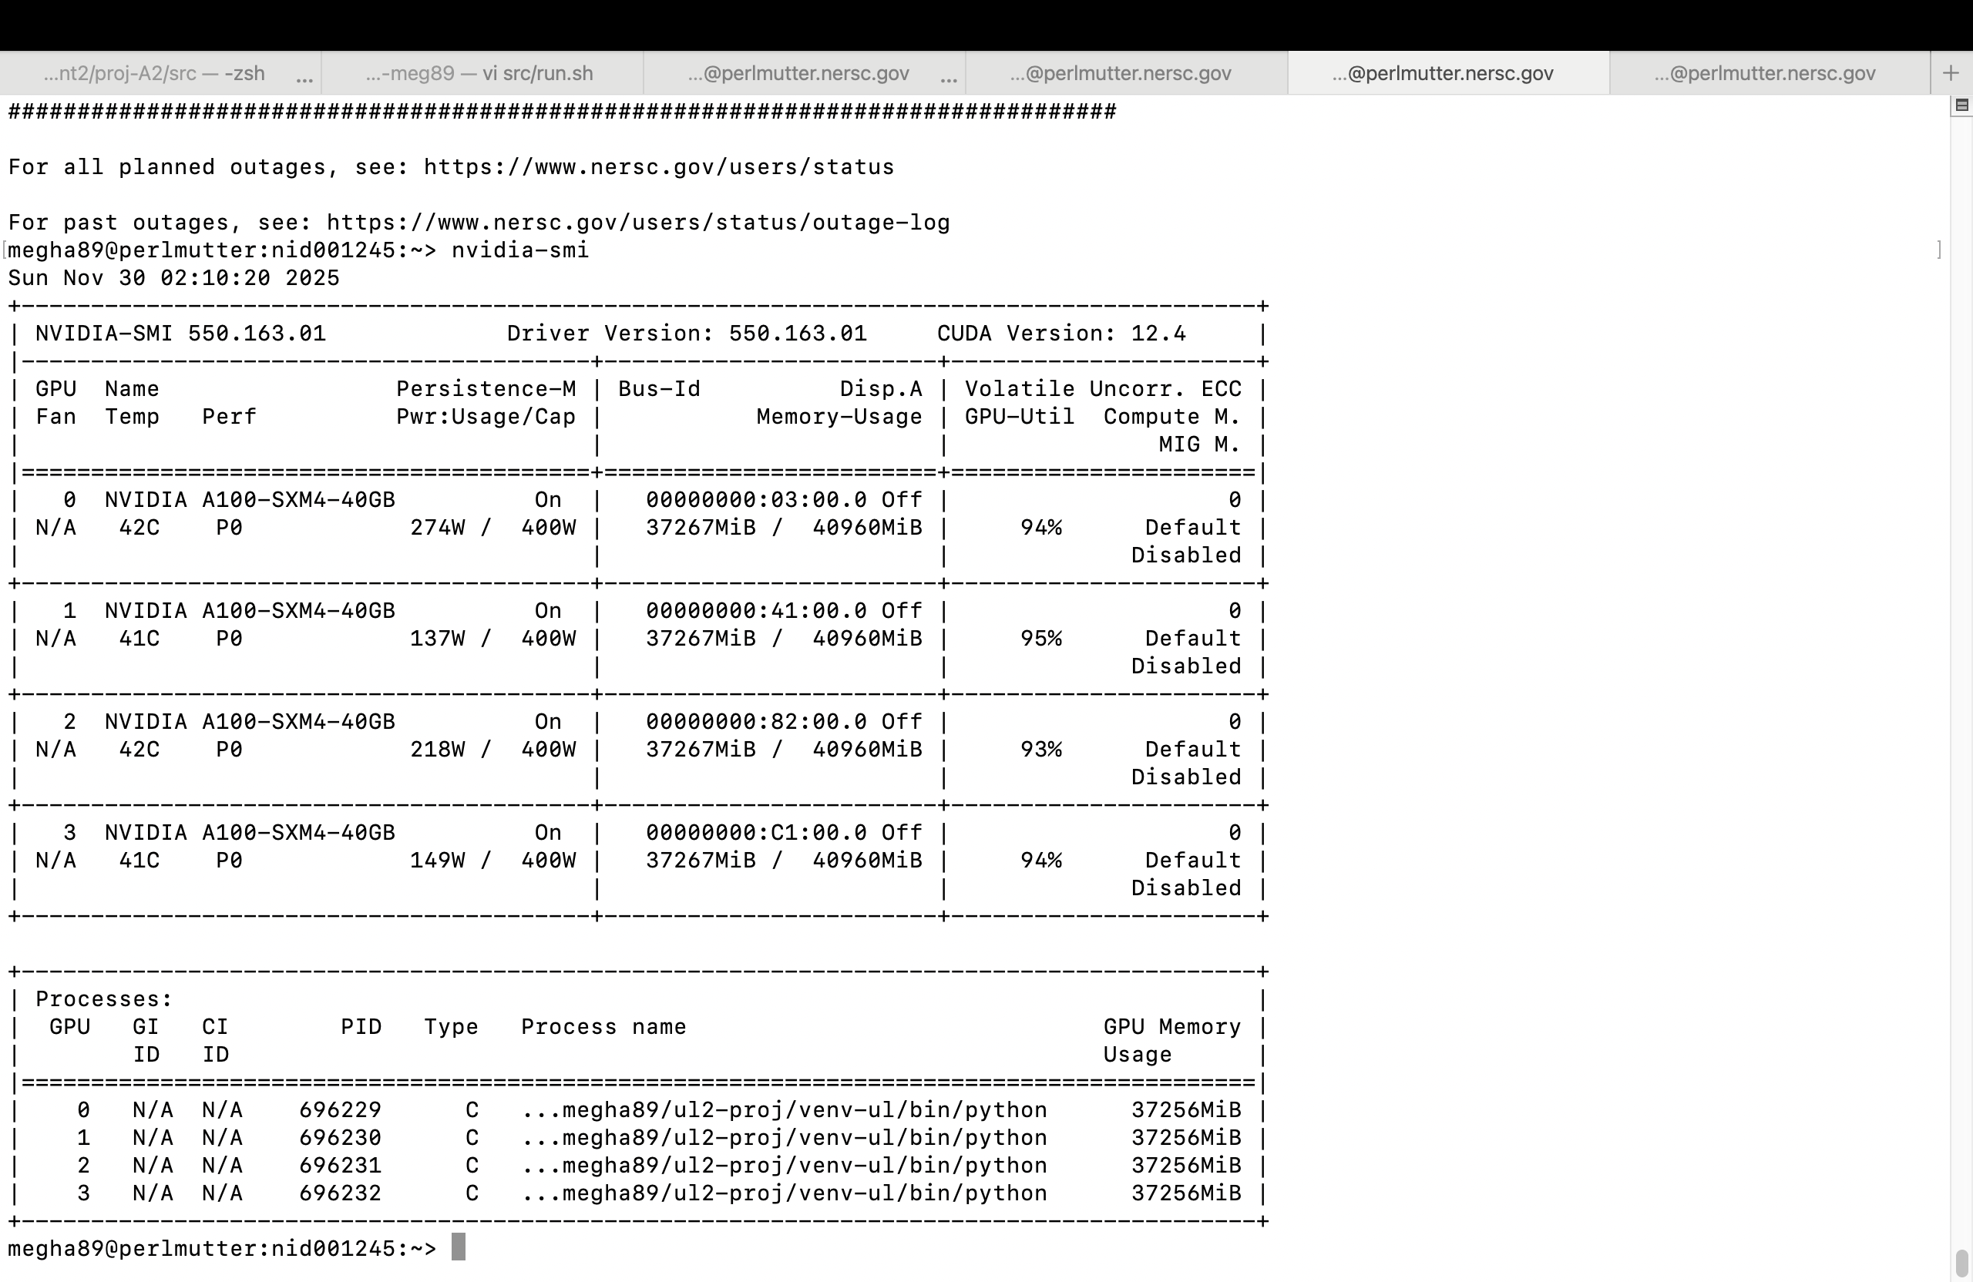



Result Analysis- Experiment 3
Nvidia-smi based GPU utilizations during summary

Slide 16
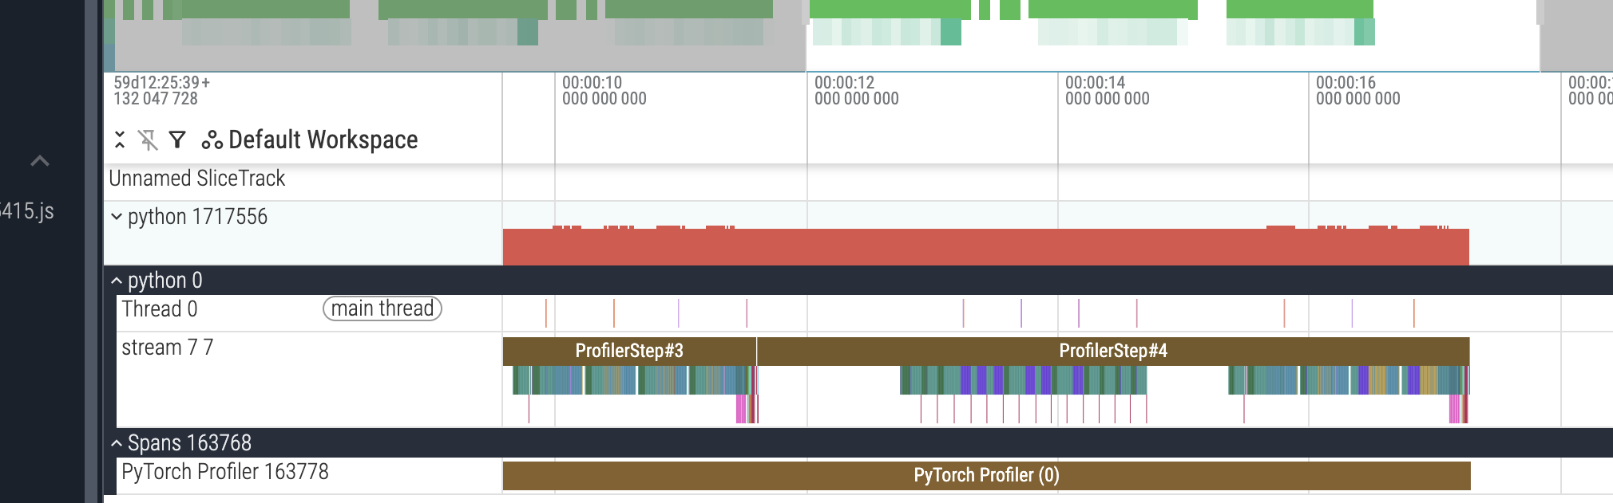
Result Analysis- Experiment 3- PytorchProfiler
File trace size: 11GB
Can analyze stepwise, operations-wise memory utilized
Helpful to find memory bottlenecks and improve memory optimized training

Slide 17
GPU hour usages and GPU Utilization
Total GPU hours used so far: 110 hr
Till mid term: 25 hrs
After Mid term: 85 Hrs
Experiment 1 final run: ~6 hr 30 min
Experiment 2 final run : ~3 hrs
Experiment 3 final run : ~ 40 hrs
Research, experimenting, debugging: ~35 hrs

Slide 18
Challenges & Future Scope
Challenges:
Memory profiling visualization
Debugging OOM error
Finding optimal size of hyperparameters and GPU numbers by running multiple runs
Trials to use ADAM optimizer offloading but not successful
Future Scope:
Improve the codebase for MultiGPU memory visualization
Change batch size dynamically, where GPU utilization is not maximum
Extend code base to develop a tool to optimize the hyperparameters selection by only giving the model and dataset information
Opensource contribution to Deepspeed library to integrate this Memory profiler framework
Opensource the profile traces for DDL research community

Slide 19

Conclusion (Progress, Discussions)
Progress : Completed
Report : pytorch profiler trace analysis
Successfully able to:
Profile memory for deepspeed zero 1/2/3 sharding techniques
Fine tune 20 billion parameter model on 1K+ sequence length with ~90% gpu utilization
Train on distributed HPC environment
Learning Outcome:
Distributed training on a HPC cluster
Understanding of memory error debugging, memory estimation insights
Fine tuning of LLM models

Slide 20
Question & Answers
Is it a good idea to increase the GPU numbers to solve the activations and overhead related OOM errors ?

Slide 21
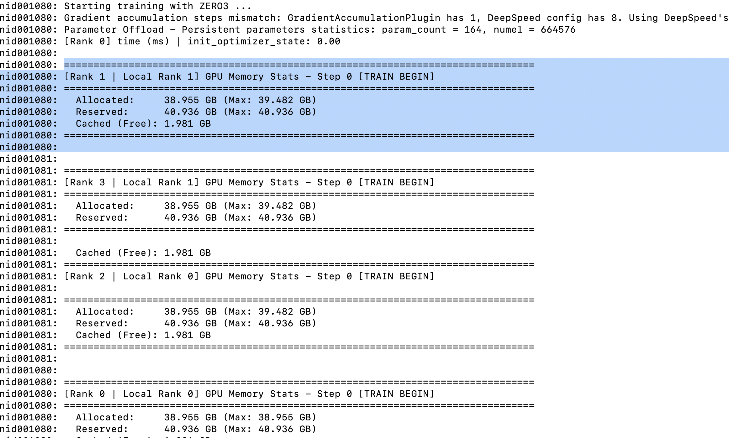
Backup Slides(1)
Initial memory allocated while loading ul20 on 4 GPUs

Slide 22
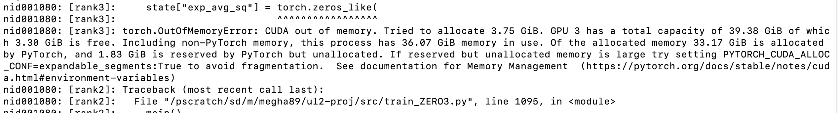
Backup Slides(2)
Memory allocated while used 8 GPUs with UL2
nid001080: ================================================================================
nid001080: [Rank 2 | Local Rank 2] GPU Memory Stats - Step 0 [TRAIN BEGIN]
nid001080: ================================================================================
nid001080: Allocated: 19.494 GB (Max: 20.021 GB)
nid001080: Reserved: 25.503 GB (Max: 25.503 GB)
nid001080: Cached (Free): 6.009 GB
nid001080: ================================================================================

Slide 23
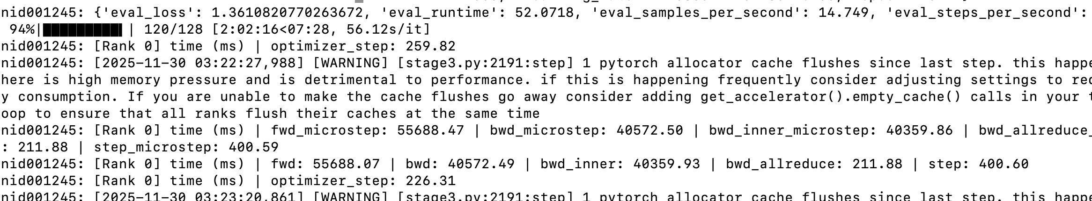
Backup Slides(3)
Memory stress while training UL2 on 16 GPUs

